Slide 1
Scalable cloud based solution
Shruti Verma 13-10-2024

Slide 2
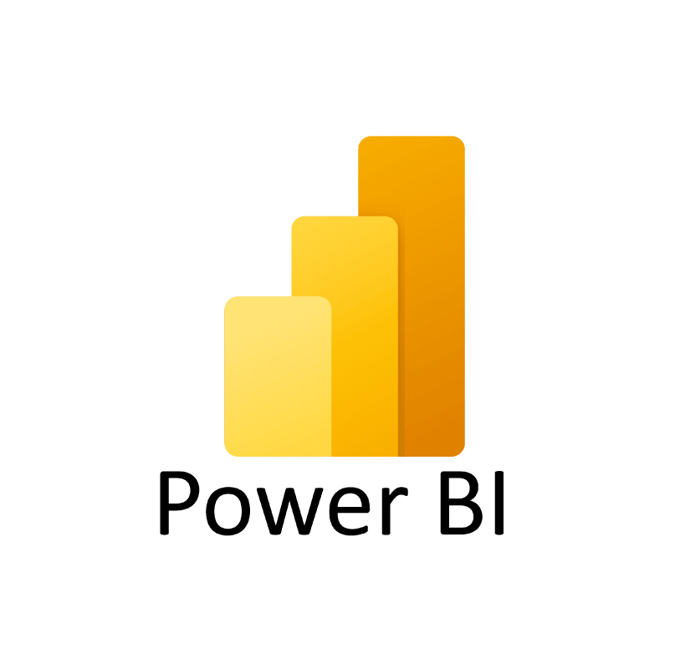
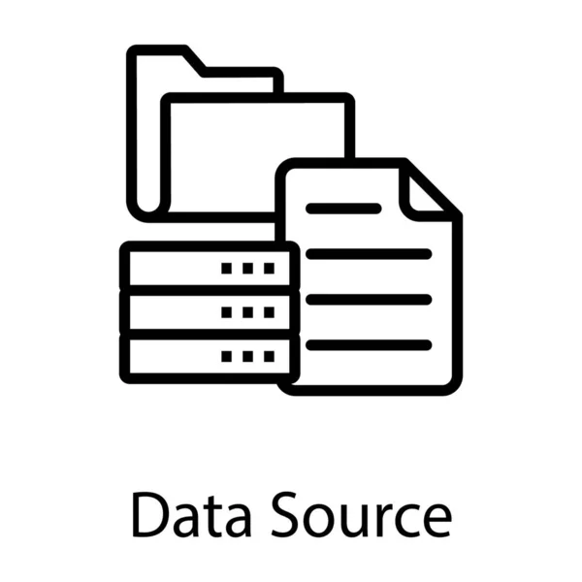
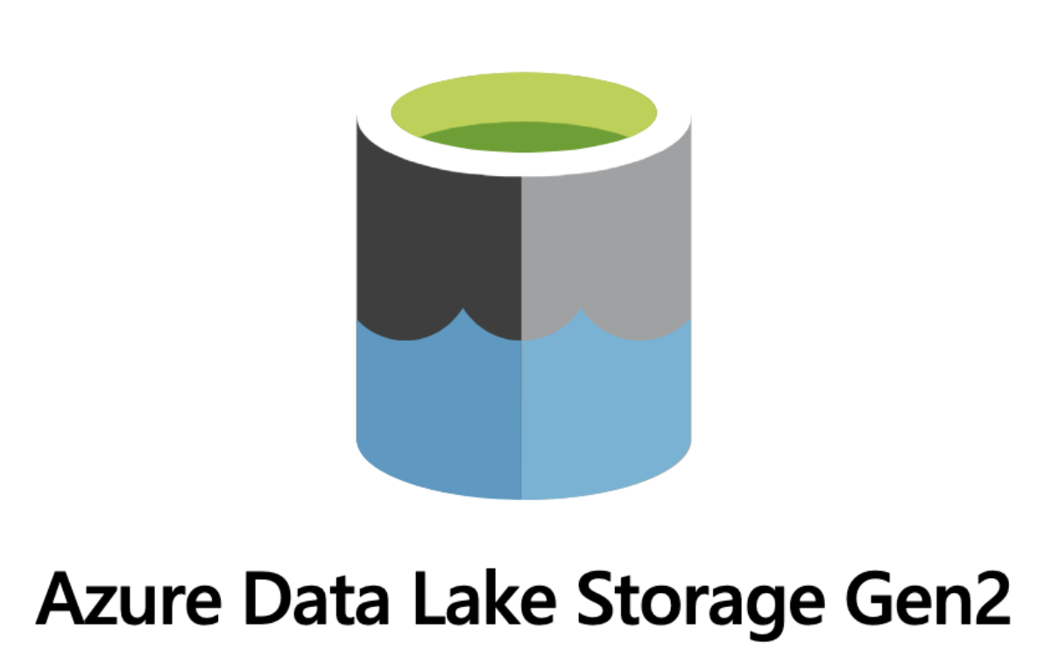
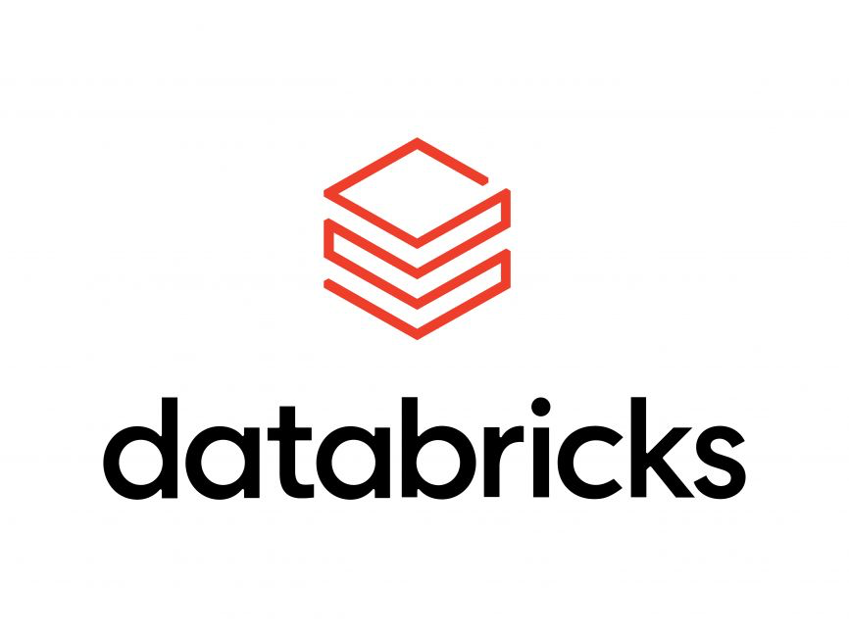
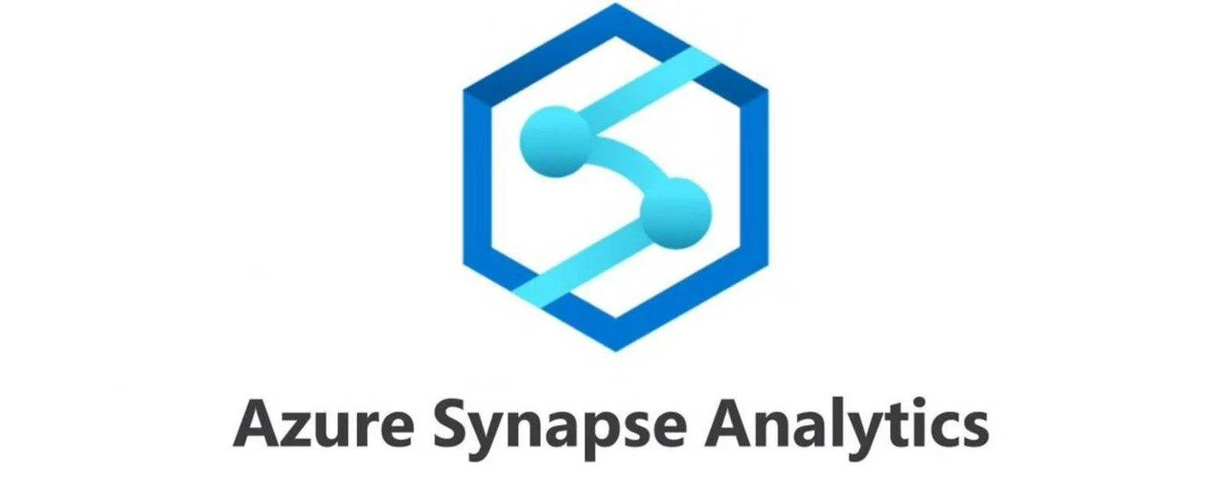
Architecture Overview
Data Source: On-prem systems push daily incremental snapshots to Azure Data Lake Storage (ADLS) Gen2.
Data Ingestion and Transformation: Azure Databricks is used to ingest the daily datasets from ADLS, perform necessary transformations, and store the transformed data in an optimized format.
Data Warehousing and Querying: Transformed data is moved into Azure Synapse Analytics to support structured querying and dashboarding.
Dashboarding and Reporting: The data is made available in Power BI for the MS team to generate daily dashboards.
Orchestration and scheduling: Azure data factory or Airflow can help on this based on user requirement

Slide 3
Solution Design
Data Ingestion with Azure Databricks
Why Databricks?
Azure Databricks provides an ideal platform for distributed big data processing and can seamlessly integrate with ADLS. It also supports both batch and real-time ingestion, which is crucial for handling daily data updates.
Ingestion Pipeline:
Load Data: A scheduled Databricks job will run daily to load incremental snapshots from ADLS Gen2 into a staging area within Delta Lake (a highly scalable data lake).
Validation: During ingestion, data validations (schema checks, null value handling, etc.) are performed to ensure data quality.
Delta Lake Storage: The data will be stored in Delta Lake to manage large-scale data effectively, using ACID transactions and data versioning for high reliability.
Data transformation and processing
Transformation: Using PySpark or SQL within Databricks, the MS team can apply necessary transformations such as filtering, joining, or aggregating the data.
Data Enrichment: Databricks can enrich the datasets by combining them with additional data sources (e.g., third-party data or internal data stored in ADLS).
Optimized Data Storage: The transformed data will be written back to Delta Lake in a format optimized for querying (Parquet/Delta format).

Slide 4
Solution Design
Data Warehousing with Azure Synapse Analytics
Why Synapse?
Azure Synapse provides a unified experience for querying, analyzing, and visualizing large datasets. It integrates directly with ADLS and Power BI, offering both serverless and dedicated query pools.
Synapse Pipelines:
After transformation, data is ingested into Azure Synapse Analytics. Synapse will serve as the data warehousing layer, enabling efficient querying using SQL-based analytics.
The SQL on-demand capabilities allow for ad-hoc querying, while the dedicated SQL pool supports optimized, structured queries for more complex dashboarding requirements.
Data Partitioning and Indexing: Synapse supports partitioning and indexing, which optimizes data retrieval and ensures fast query performance, especially for large datasets.
Data Accessibility via PowerBI
Direct Connectivity: Power BI can be directly connected to Synapse SQL pools, allowing the MS team to build real-time, interactive dashboards.
Optimized Performance: Using Synapse for querying ensures that Power BI dashboards are fast and scalable, even with large datasets.

Slide 5
Solution Design
Monitoring,Security and Compliance
Monitoring:
Azure Monitor and Log Analytics will track the ingestion and processing pipeline, ensuring that the system meets uptime and performance SLAs.
Alerts will be configured for any failures or performance issues in the pipelines.
Security:
Role-Based Access Control (RBAC): Access to the data will be controlled using Azure Active Directory (AAD) roles, ensuring that only authorized users can access the data.
Data Encryption: Data at rest will be encrypted using Azure Storage encryption, and data in transit will be secured using TLS.
Compliance: The solution will comply with banking regulations, including data retention policies, encryption standards, and audit logging.

Slide 6
Detailed Workflow
Data Capture (On-Prem to ADLS Gen2):
  Daily data snapshots are transmitted from on-prem systems to ADLS Gen2. This raw data includes all the necessary information that the MS team will use for reporting.
Ingestion and Staging (Azure Databricks + Delta Lake):
  Databricks picks up the daily data from ADLS Gen2 and loads it into a staging area within Delta Lake.
  Data validation checks are performed to ensure completeness and accuracy.
Data Processing (Databricks):
  Transformations are applied to the data (e.g., cleaning, joining with other datasets, filtering).
  Processed data is written back to Delta Lake for optimized storage.
Data Warehousing (Azure Synapse Analytics):
  Data from Delta Lake is moved into Synapse Analytics for querying.
  The Synapse SQL pools support structured queries that the MS team can use for their dashboards.
Visualization (Power BI):
  Power BI dashboards are connected to Synapse Analytics, providing MS with interactive, real-time reports on the latest data.
  Dashboards update daily as new data snapshots are ingested, processed, and loaded into Synapse.
Monitoring and Alerting:
  Azure Monitor tracks the status of the pipelines, and alerts are triggered if any issues arise.

Slide 7
Benefits of proposed solution
Scalable: The system can easily scale as the volume of data increases, thanks to Azure Databricks’ distributed computing capabilities and Synapse’s scalability
Efficient: Delta Lake provides optimized storage and querying capabilities, reducing the latency between data ingestion and reporting.
Secure: The solution leverages Azure’s security features (AAD, RBAC, and encryption) to ensure data privacy and compliance with banking regulations.
Real-Time Access: MS team members can access up-to-date data through Power BI, with minimal latency between data ingestion and reporting.
When to Choose ADF:
If you are primarily working within the Azure ecosystem and need a tool for data ingestion, transformation, and loading (ETL) processes.
When you prefer a low-code, visual interface that doesn’t require deep technical knowledge.
If you want a fully managed service with little infrastructure management or overhead.
For teams focusing on data movement and batch processing workflows within Azure.
When to Choose Airflow:
If you need flexibility and customization to handle complex workflows across various environments.
For teams that prefer a code-first approach using Python and require custom task dependencies.
If you’re operating in a multi-cloud or hybrid environment and need a more cloud-agnostic solution.
If you want a more general-purpose orchestration tool capable of handling non-ETL workflows such as API calls, DevOps pipelines, or machine learning workflows.

Slide 8


